Slide 1

Potential Accounting fraud IN U.S. public companies
Northwestern Data Science and Visualization Project #3
Saturday, October 2, 2021
JMDZ (Jackson, Mack, Deutsch, Zaki) Partnership

Slide 2
Project Steps
Books on accounting fraud detetion: seven fraud features to search for. And, Benford’s Law to identify non-random numbers in collections of quantitative data
SEC’s EDGAR API - "data.sec.gov" RESTful data Application Programming Interfaces (APIs) delivering JSON-formatted data to external customers. No authentication or API keys to access
Submissions history by filer + XBRL data from financial statements (forms 10-Q, 10-K)
Retrieved three years of quarterely filings for all companies filing with SEC
Mongo Glob. ~160 MBs, ~one million rows
Used Python Pandas. Math, Benford’s Law library, and Scikit-Learn to search for accounting fraud in the Glob (10-Q financial statements of publicly listed U.S. companies)
Features/Benford’s law, attempt to Identify U.S. publicly listed firms with potential accounting fraud
Machine Learning - Random Forest – tags as columns. Summed values for each submission. Model uses five additional features to determine likelihood that based on the inputs for quarter, a company will have a positive or negative net income.

Slide 3
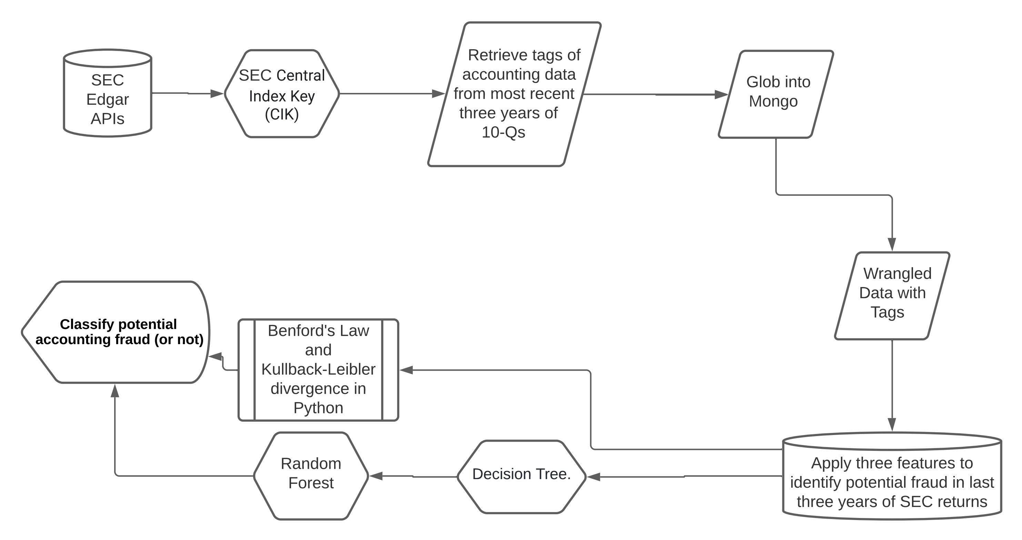

Slide 4
Lessons Learned
Time vs. ambition
SEC’s EDGAR API allows non-normalized taxonomy to “tag” accounting entries
Not all companies file “revenues”, for example. FASB taxonomy and switched tags
Coding to search for accounting fraud in the Glob was dataframe trial and error. Very complex, tricky
Benford’s law seems to identify abundant non-random numbers/potential accounting fraud
Machine Learning - Random Forest – to determine if any of the features are better predictors of potential fraud than others.

Slide 5
